Slide 1



Fabiana Rubba
Il Ruolo dei Gom nella Formazione del Chirurgo

Slide 2

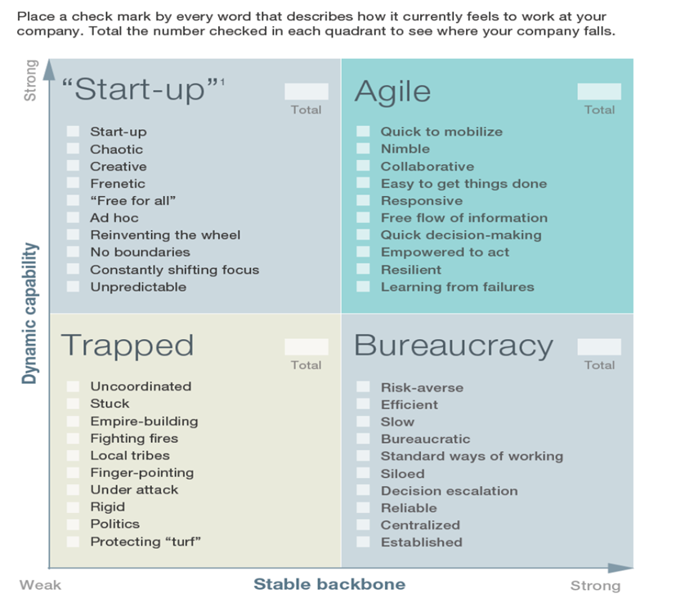
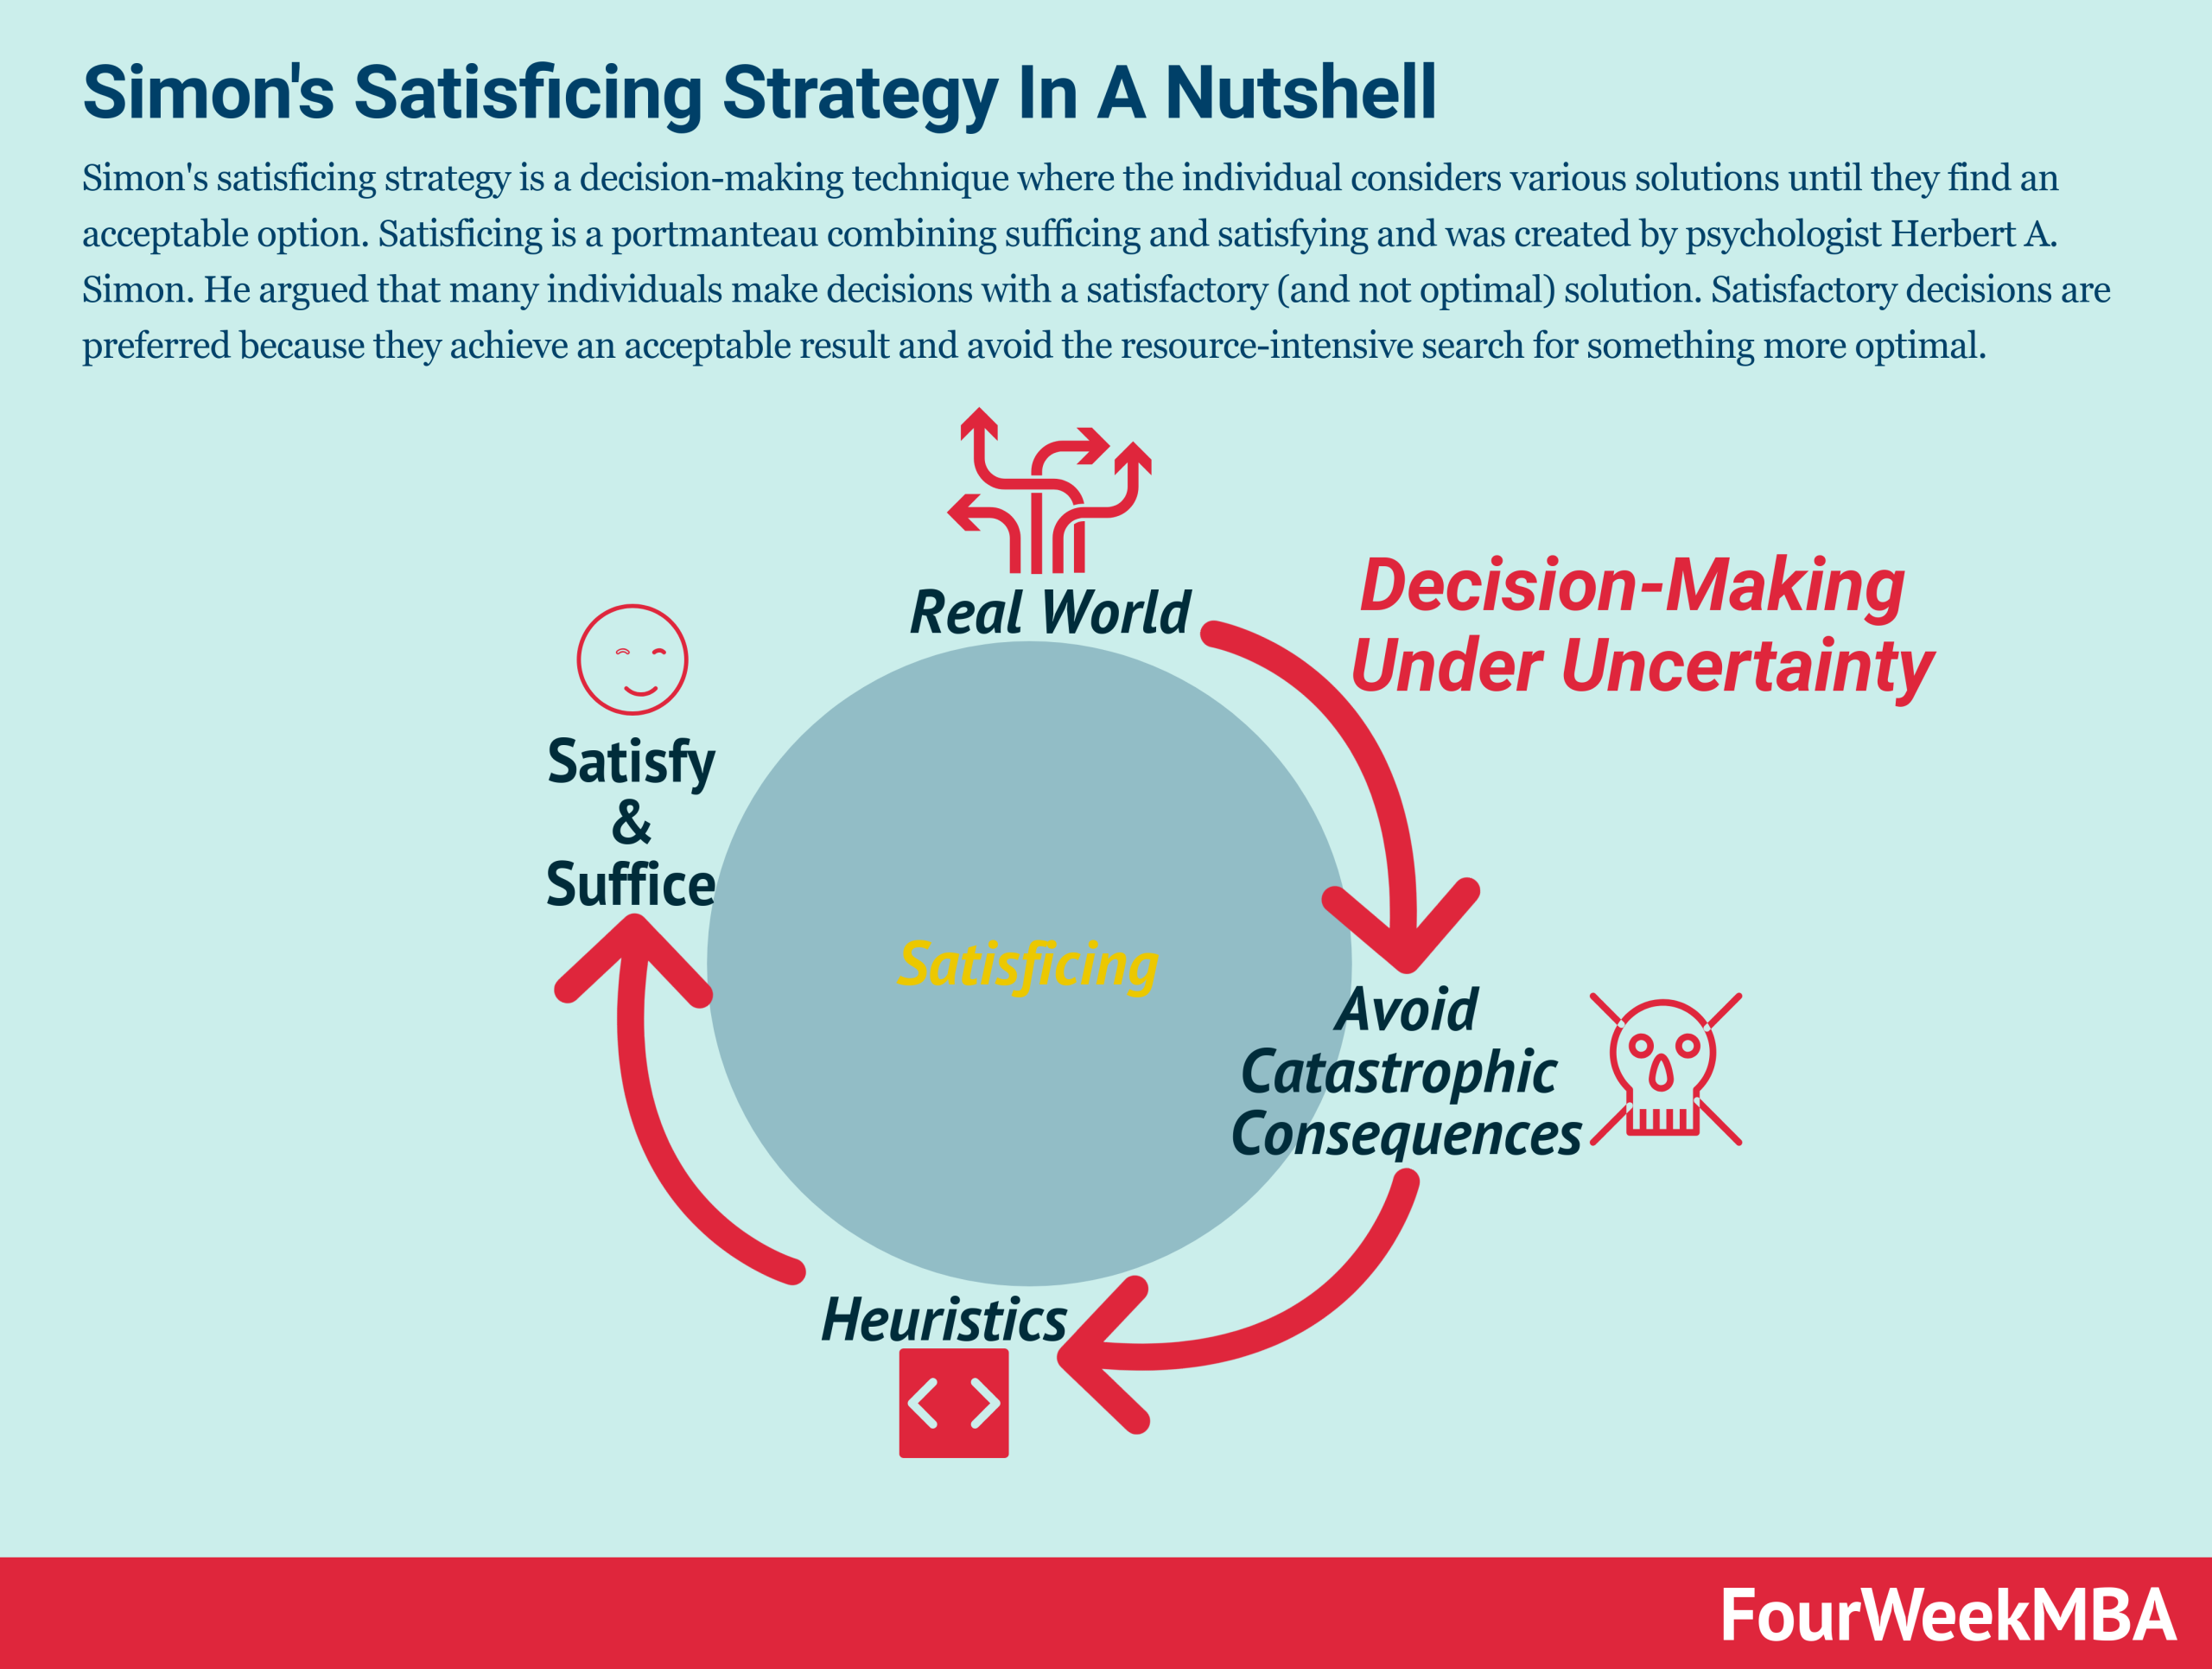
H Simon has been awarded this year’s prize in economics for his research into the decision-making process within economic organizations, but he has also made other important contributions to the science of economics. For example, his interest in simplifying and understanding complex decision-making situations led him at an early stage to the problem of breaking down complex equation systems. His studies of “causal order” in such systems have been of particular importance.
medicine is an example of connected path

Slide 3
Valutazione dei DRG Chirurgici 2022 secondo analisi di pareto
ANNO 2022 ( data base dinamico)
( Courtesy Of Dr R Egidio)

Slide 4
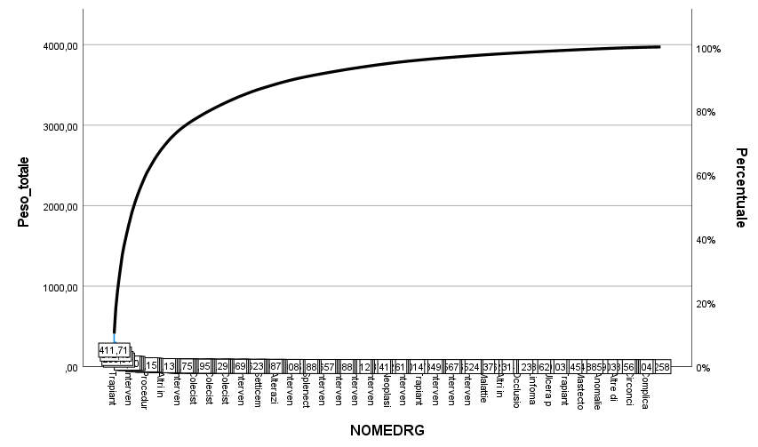
INTERVENTI AOU 2022 = 2497

Slide 5
TOP 20

Slide 6
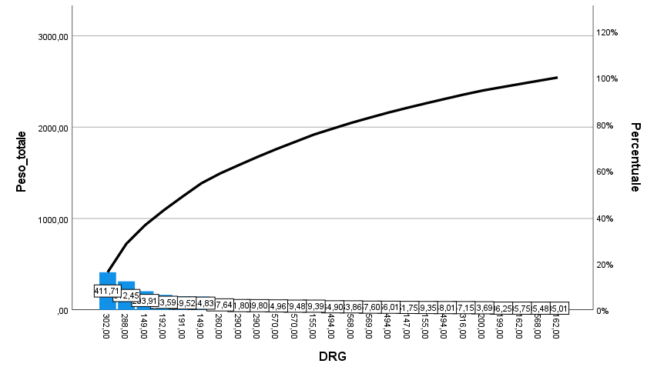
A
B

Slide 7
TOP 20 PESATI sono 1346 su 2497 interventi totali
208 /18%
285 /16,5%

Slide 9

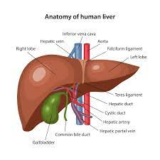
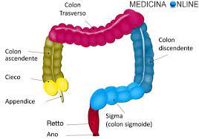
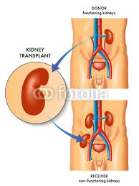
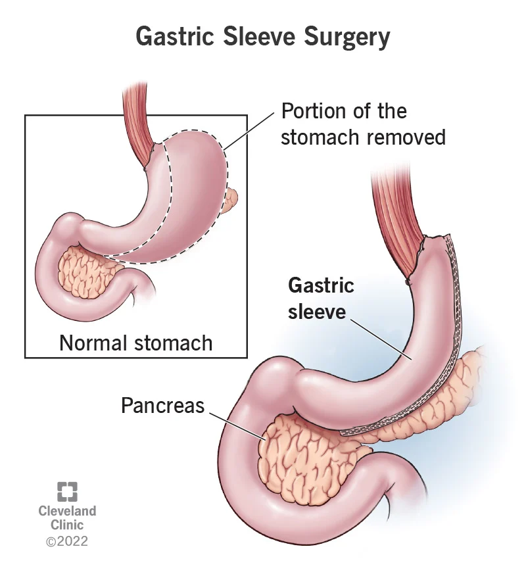
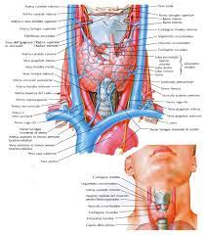
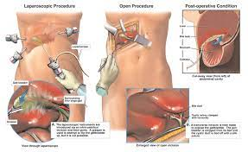
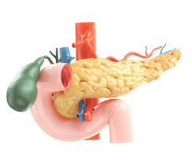
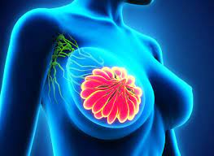

Slide 10
L’importanza dei volumi
Regional Collaboration and Trends in Clinical Management of Thyroid Cancer, 2023
Conclusion: The establishment of a regional oncological network coincided with a de-escalation of thyroid cancer treatment and centralization of complex patients and interventions. However, no differences in postoperative complications over time were observed. Determining the impact of regional oncological networks on quality of care is challenging in the absence of uniform quality indicators.

Slide 11
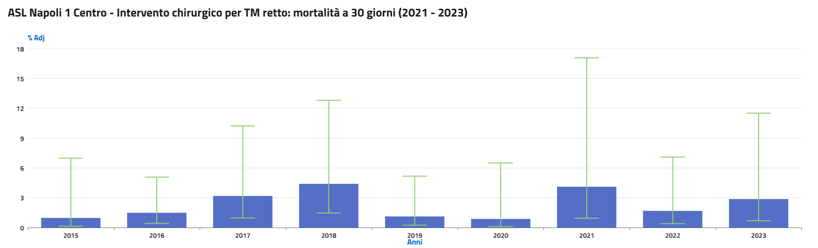
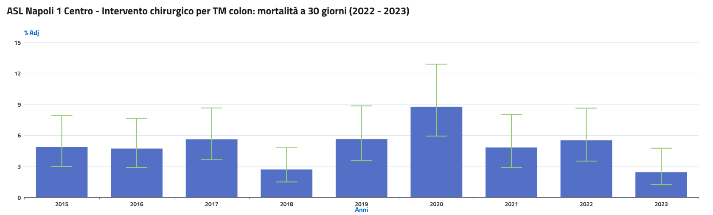
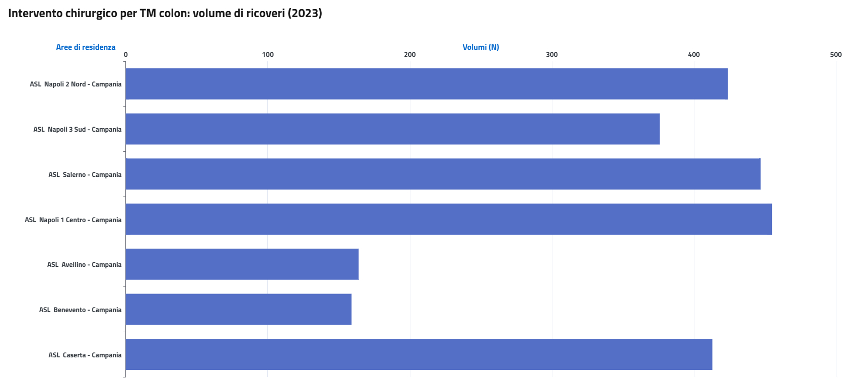
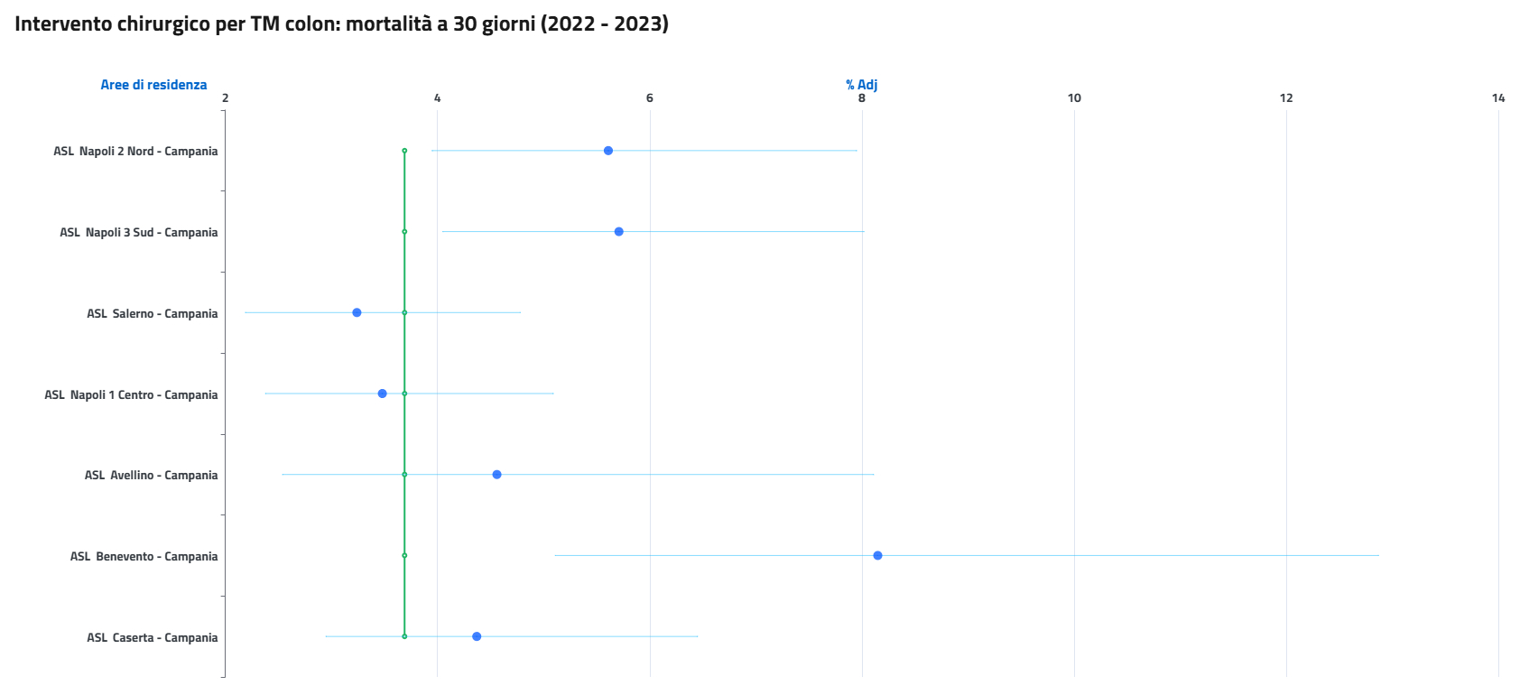
DATI PNE

Slide 12
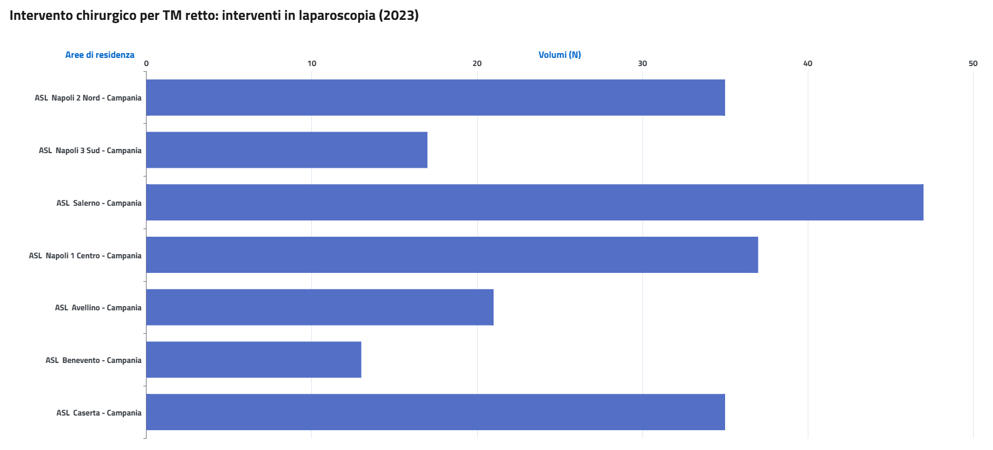
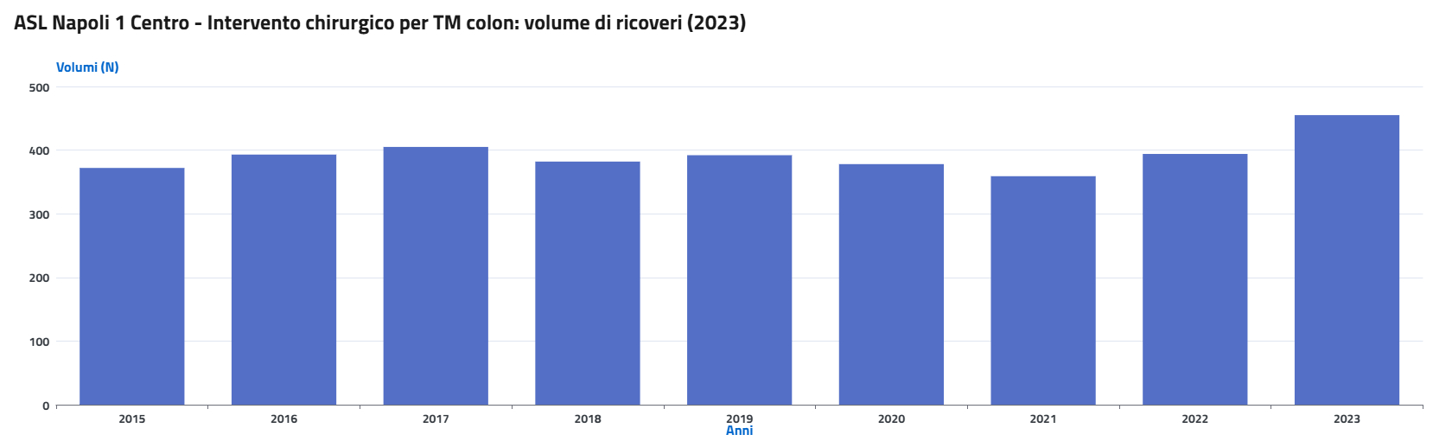
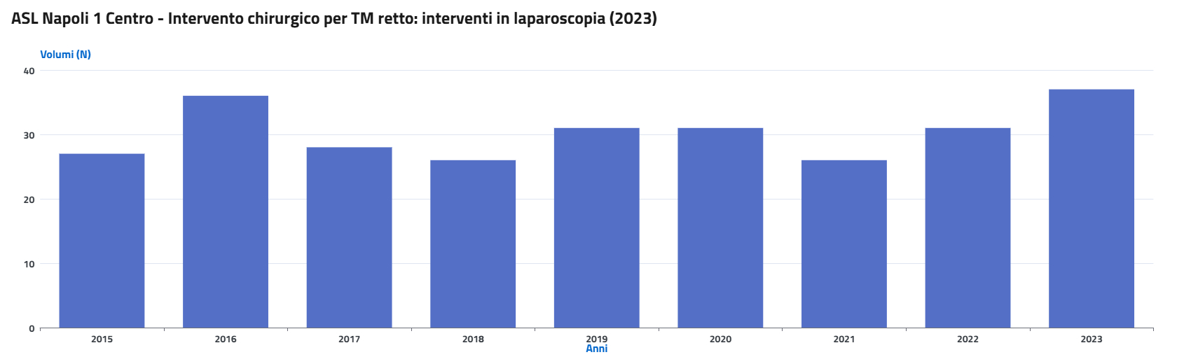
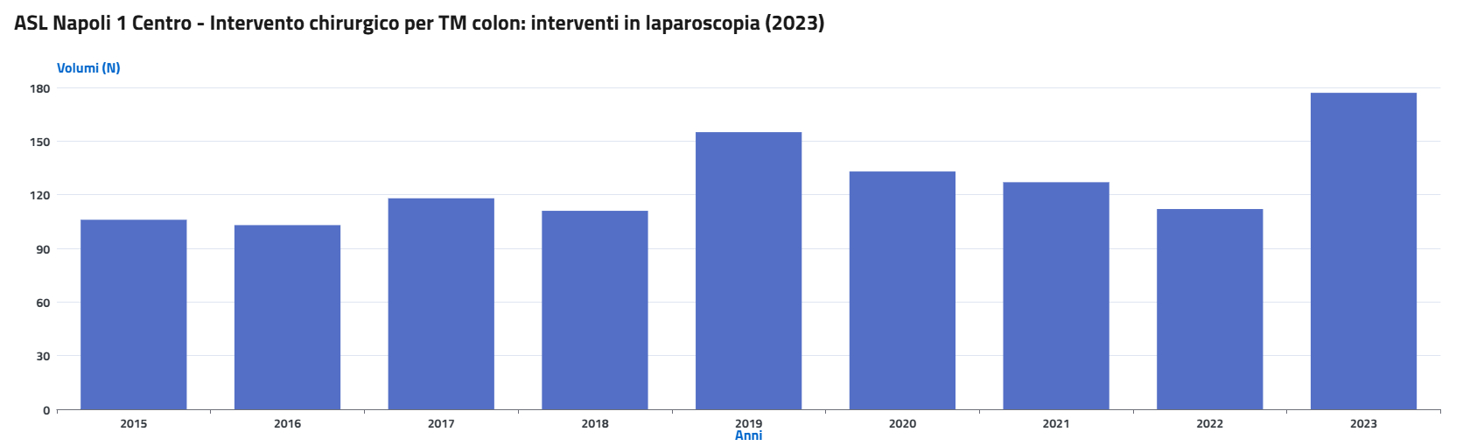
DATI PNE

Slide 13


LIVER METASTASIS RENDERING
PER CHIARIRE IL MODELLO EVOLUTIVO DELLA MALATTIA METASTATICA
Una ipotesi di interazione con il Tumor Molecolar Board

Slide 14
What Are Spandrels?
Spandrels are byproducts of evolution. They arise due to the evolution of one trait, but this unintended trait may not have any function.
Gould and Lewontin called these nonadaptative by-products that "become available for later and secondary utility" "spandrels". In masonry vocabulary,spandrels are triangular spaces between two arches or between an arch and a supporting dome
Gould and Lewontin defined a biological spandrel as a byproduct of evolutionary adaptation. Simply put, they’re like ‘leftovers’ of some other trait that evolved. This means that the spandrel isn’t an adaptation to anything in the environment. Instead, it is a secondary trait that arose from the development of another primary trait.
The easiest spandrel to visualize is the human chin. On hypothesis about why humans are the only animals that have a chin is that it is merely a byproduct of the growth of different parts of the jaw.

Slide 15
Result from biochemical constraints that are "hardwired" in signaling and metabolic pathways
Several recent reports have revealed unexpected mechanisms that do not fit the gradualist scenario involving the stepwise genetic modifications of cells toward malignancy but resemble the "punctuated-equilibrium" model of speciation (34–36). In some review, it was e proposed that cooption, another concept initially developed to resolve questions raised by the Darwinian theory, may also have broad applicability in oncology. Finally, from a clinical standpoint, it is worth underscoring that components of the genetic regulatory networks co-opted during tumor progression will constitute, when identified, prime choices for designing targeted drugs

Slide 16
What about observational data
BREAST | 5
CAUDADECTOMY | 1
HEPATIC RESECTION Sg V ALLARGATA ALL'VIII | 1
MCW THERMOABLATION | 1
WEDGE HEPATECTOMY Sg2 LPS | 1
WEDGE RESECTION Sg. IV | 1
Calculous chronic cholecystitis | 1
WEDGE RESECTION Sg II e VII | 1
Cholangiocarcinoma | 1
GASTRIC | 2
ABLATION SG III-IV-V-VI | 1
WEDGE SG III SG IVb | 1
Kidney | 3
BIOPSY | 1
MESOHEPATECTOMY SG IV-V-VIII | 1
PANCREATICODUODENECTOMY | 1
MELANOMA | 1
RESECTION IVb-V+Cholecistectomy+Roux | 1
OVARIC | 1
BISEGMENTECTOMY V-VIII | 1
PANCREAS | 1
Anatomical Resection S7 | 1
PROSTATE | 1
RIGHT HEPATECTOMY | 1
UVEAL | 1
SEGMENTECTOMY SG 1 | 1
UVEAL MELANOMA | 1
EXPLORATIVE LAPAROSCOPY | 1
VATER PAPILLA TUMOR | 1
Wedge Hepatectomy Sg4a | 1

Slide 17
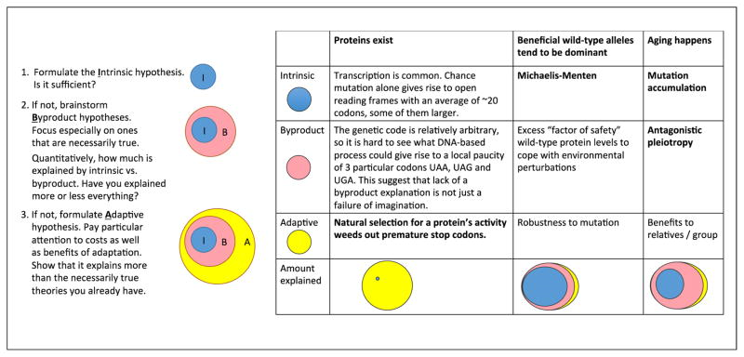
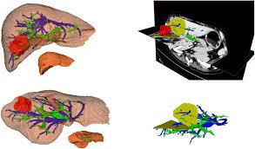
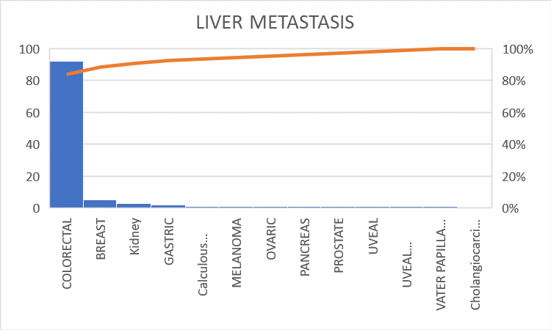
ROADMAPS

Slide 18
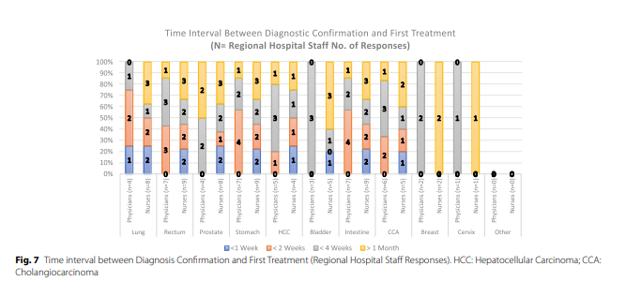
PATIENT CENTERED CARE
PROMS e GOMS

Slide 19
New approach to implement cancer patient care: The valutazione percorso rete oncologica campana (ValPeROC)-experience from an Italian oncology network
Anna Crispo, Giorgia Rivieccio, Luca Cataldo, Sergio Coluccia, Assunta Luongo, Elisabetta Coppola, Maria Grimaldi, Concetta Montagnese, Flavia Nocerino, Davide D'Errico
Objective
The primary goal of the Campania Oncology Network (ROC) was to reduce cancer delay and care fragmentation through the establishment of cancer-specific multidisciplinary oncologic groups (GOMs) and diagnostic and therapeutic assistance paths (PDTAs).
Methods
Five cancer centres of the ROC, with their own cancer specific GOM, were selected. In our analysis, we have focused on four neoplasms: lung, colon, ovarian and prostate cancers. The median time for pre-GOM and GOM Times was calculated for each tumour site. Univariate and multivariate logistic regressions were performed to individuate risk factors for pre-GOM and GOM Time.

Slide 20
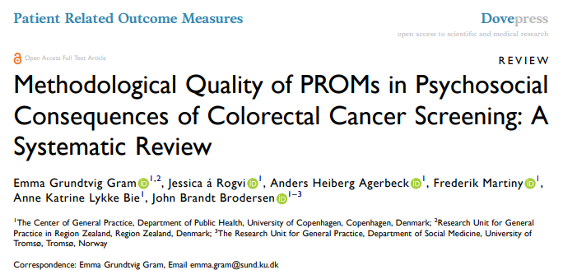
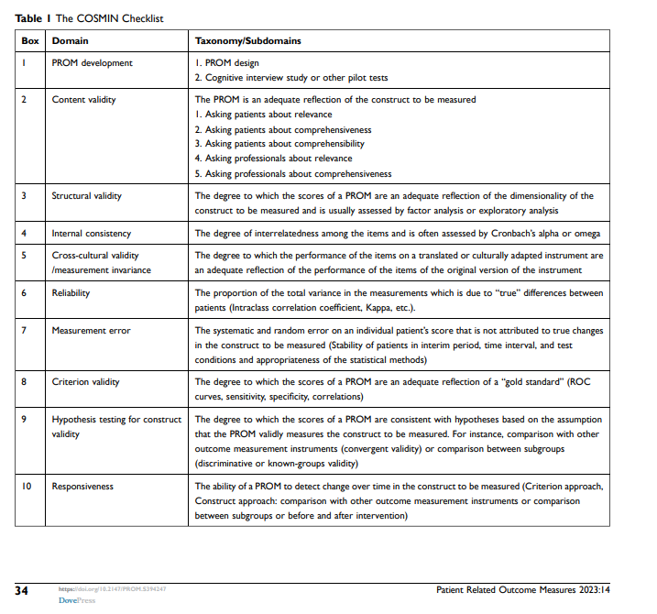

Slide 21
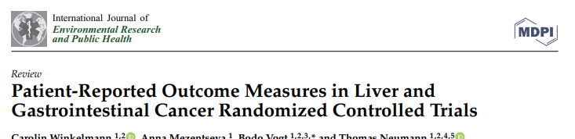
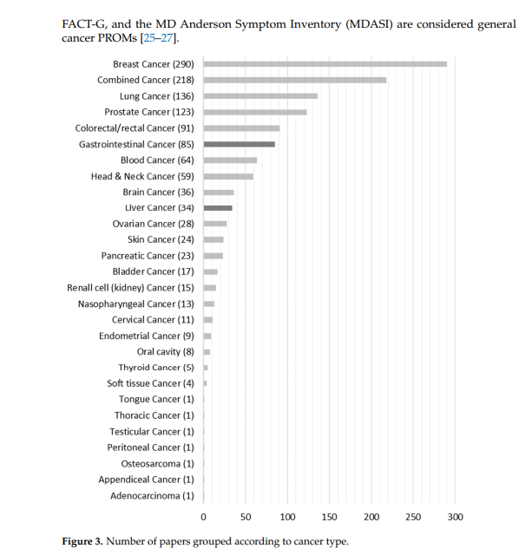

Slide 22

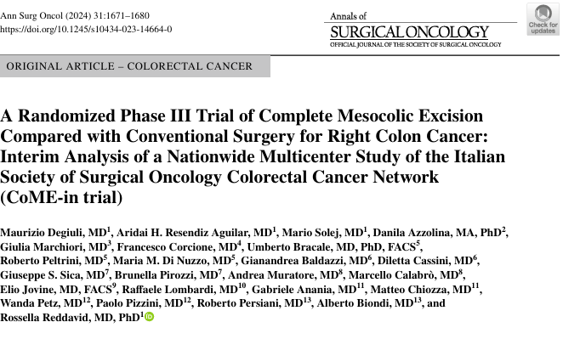
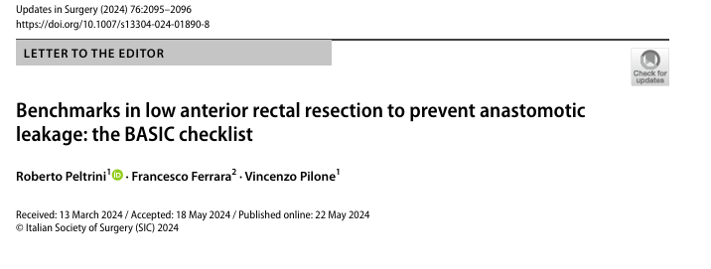
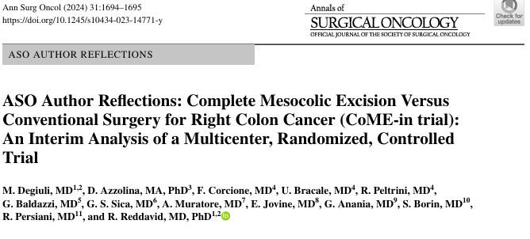
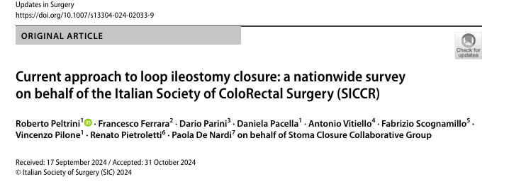

Slide 23
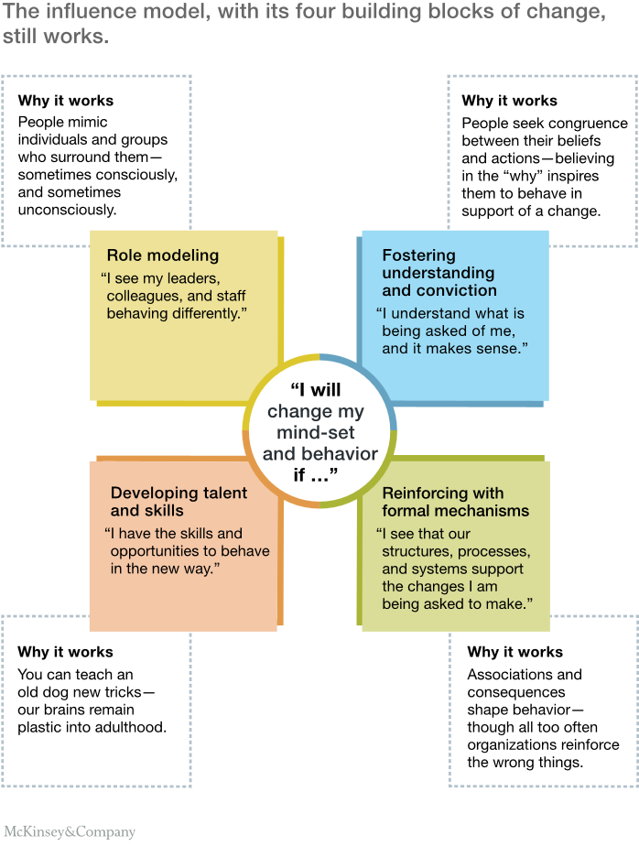

Slide 24
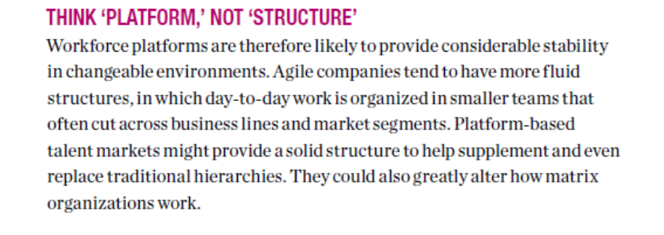

Slide 25

Making Good Decisions is a Skill
A skill is an ability to perform an activity in a competent manner.
Question: How can one develop or improve their decision making skill?
Answer: The same way as with other skills, such as playing tennis, playing the piano, teaching, or driving a car.

Slide 26
ROADMAP
Incrementare i volumi ( sorvegliando la mortalità)
Favorire la diagnostica predittiva
Integrare la percezione del paziente nel percorso GOM
Centralizzare i GOM
Lavorare sui tempi e sui percorsi multidisciplinari
Sperimentare una griglia specifica di indicatori PROMS

Slide 27
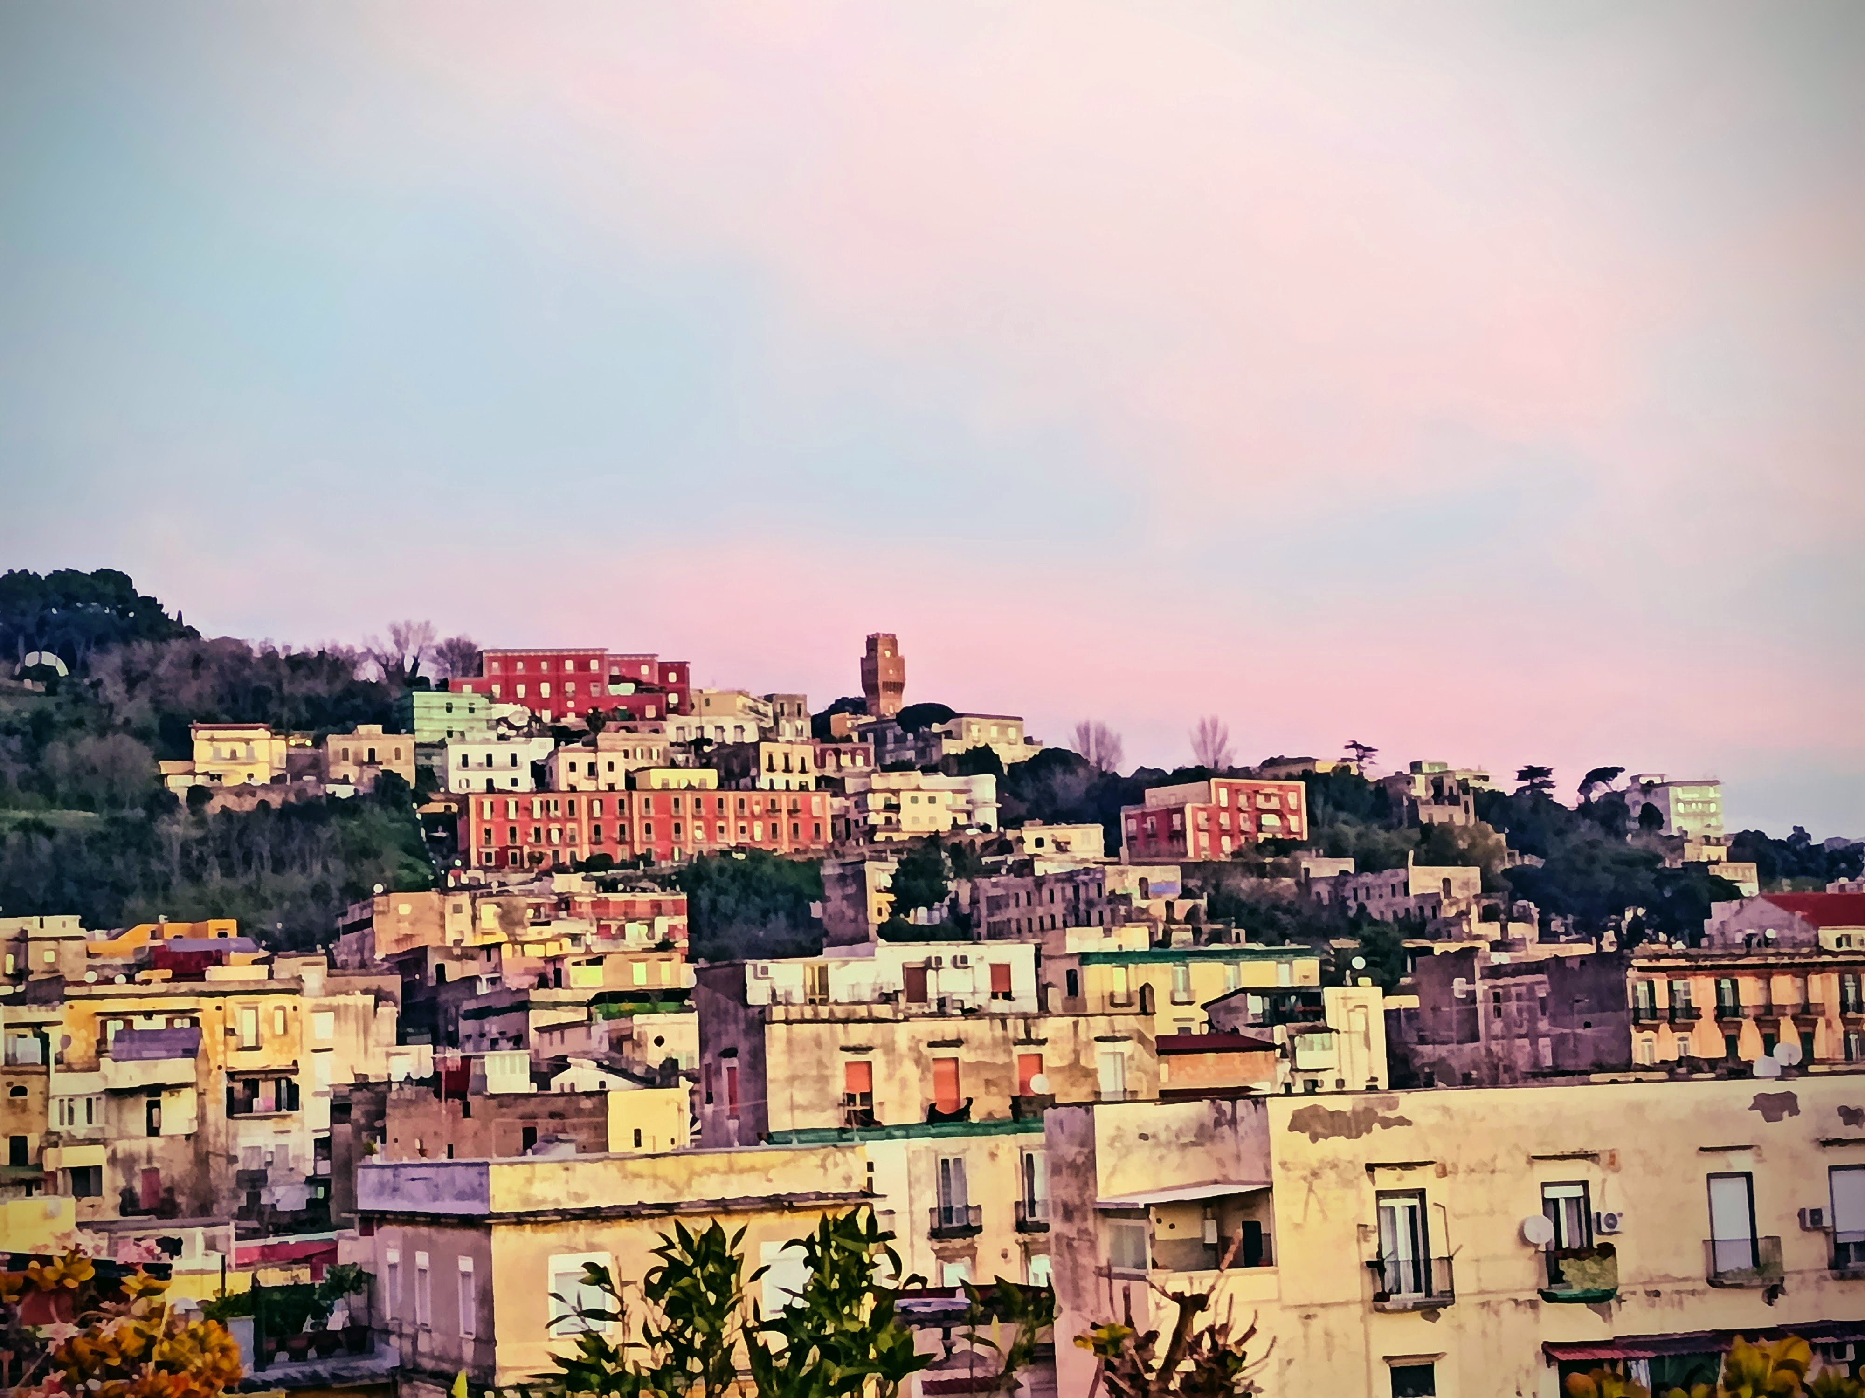
Il Ruolo dei Gom nella Formazione del Chirurgo
«Erano i momenti in cui la ferita è il centro del mondo e tutt’intorno non ci sono che inconsistenze. E’ la ferita del tuo corpo e dell’intera umanità. Dunque le sue mani erano entrate in una sacra sintesi della fragilità universale. Non avevano avuto incertezze, sapevano perfettamente come si fa a scendere e a risalire da profondità guaste e indimenticabili.»
Wanda Marasco
Di spalle a questo Mondo
Neri pozza, Vicenza(2025)

